Slide 1


WHAT YOU NEED TO DO Being Future-Oriented
Think about future opportunities in the market and make notes on how you can use them for your business.
Think about the barriers that might arise in the future and prepare for them now.
Always anticipate long-term consequences before acting on future opportunities and barriers.

Slide 2
NOT Looking into the Future
The Lost Son did not look into the future when he took his inheritance and spent every last penny
The result? He was left starving among pigs who were better fed than he…
Luke 15: 11-32

Slide 3
WHAT YOU NEED TO DO If ‘A’ then ‘B’ Reasoning Technique
IF ‘A’
HAPPENS
I WILL DO ‘B’
THEN
If I don’t sell all my tomatoes at the local market this week…
I’ll make tomato sauce and sell it in jars at the next market
THEN
Example:

Slide 4
If ‘A’ happens then I’ll do ‘B’
Joab was fighting the Arameans with his brother Abishai and their army of hired Ammonites
Joab reasoned and said to Abishai ‘if ‘A’ happens - one of the foes is too strong - then ‘B’ - the other one comes to their rescue
2 Samuel 10:11

Slide 5

WHAT YOU NEED TO DO Being Future-Oriented
Example to anticipate OPPORTUNITIES using the "if A, then B" technique:
If the road to Nairobi is upgraded at the end of the year...
...I will look for suppliers in the city who offer a lower price or higher quality.
...I will join an association of entrepreneurs
...I will plan to offer my products in Nairobi as the transport is faster and cheaper
Example to anticipate BARRIERS using the "if A, then B" technique:
If the electricity company cuts the power again next week...
...I will use my own generator or share one with others.
...I'll have a machine at hand that doesn't need electricity for this.
...I will have as many spare parts in stock as I need to produce until the power comes back on.
Notes:
Integrate graphics (new slides on If A then B) from Artemis

Slide 6



EXAMPLE Being Future-Oriented
Example to anticipate long-term CONSEQUENCES
Karobia runs a kiosk near a school. His customers are mainly students and teachers. He’s been successfully running his business for a few years. A few weeks before the start of the school year, Karobia learns about a new restaurant opening right next to his kiosk. He’s afraid students and teachers will buy from the new competitor, so he decides to reduce the prices of almost all his items.
In fact, Karobia gains some customers. But at the end of the school year, he finds he’s made a huge loss.
What did Karobia do wrong?
%

Slide 7

Exercise: Identifying proactive vs. reactive behaviour
EXERCISE: Preparing for changes
in the environment
Instruction:
Note current and future technological changes, demographic changes and social trends in Kenya. Think of as many changes, small or large, as possible.
DEMOGRAPHIC AND SOCIAL CHANGES
TECHNOLOGICAL CHANGES
OTHER CHANGES
Notes:
Categories may be a little bit too abstract.
Examples for changes need to be adapted to the respective context.
Maybe only introduce only the most relevant changes for the country.
+ add ecological aspects

Slide 8
GET READY FOR CHANGE
The seven years of abundance in Egypt came to an end, and the seven years of famine began, just as Joseph had said. There was famine in all the other lands, but in the whole land of Egypt there was food.
Genesis 41: 47-49 & 53-57

Slide 9
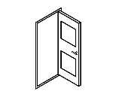


Exercise: Identifying proactive vs. reactive behaviour
WS 4
EXERCISE: Preparing for Changes
in The Environment
Instruction:
Work in groups of 04 or 05. Select a change, and a business/idea from a member of your group. Discuss the following questions:
What are the potential opportunities for the business arising from this change? List at least 3 opportunities.
What are the potential barriers for the business arising from this change? List at least 3 barriers.
Choose a potential opportunity, and a barrier. Note the steps required to take advantage of the opportunity, and to avoid or overcome the barrier
Remember the if ‘A’ then ‘B’ technique
EXAMPLE
Notes:
Focus on If A, then B

Slide 10
Exercise: Identifying proactive vs. reactive behaviour
EXAMPLE: Preparing for Changes
in the Environment
Example:
Change: Rising Cost of Food
Company: Njoroge’s Food Store
Potential opportunities:
Cut out middlemen and buy some items from producers
Potential barriers:
Idea can be copied by other retailers

Slide 11
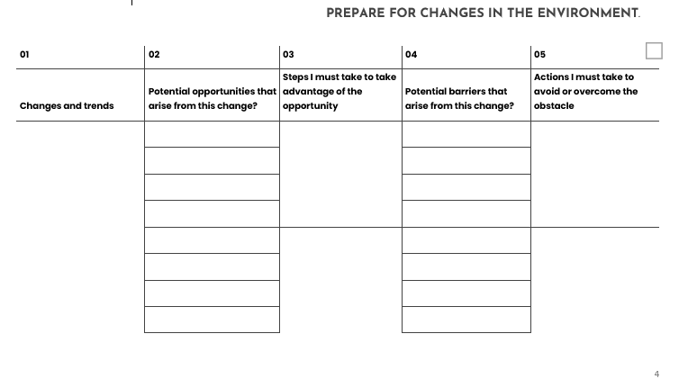
Exercise: Identifying proactive vs. reactive behaviour
WS 4
EXERCISE: Preparing for Changes
in The Environment
Notes:
Focus on If A, then B

